Slide 1
With Python

Slide 2
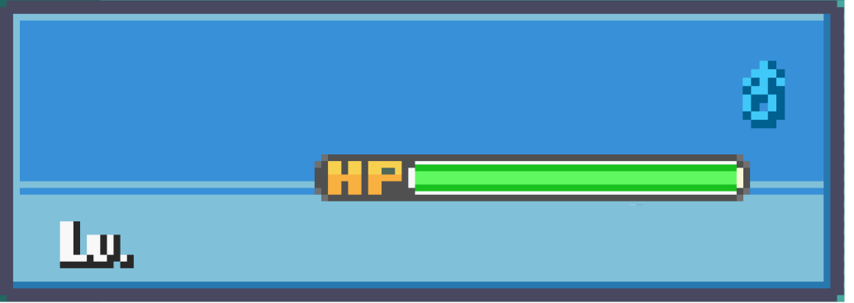

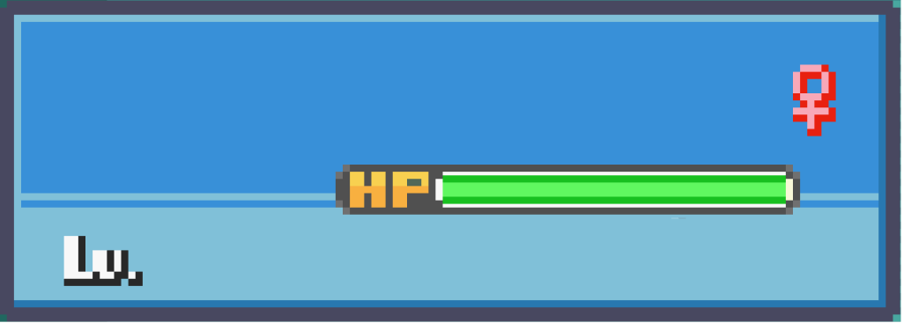
Team Members
Pranav H
Pragathi P
18
PES1UG23CS433
19
PES1UG23CS433
Noel Jose
Pranav R
18
PES1UG23CS433
18
PES1UG23CS435
NEXT

Slide 3
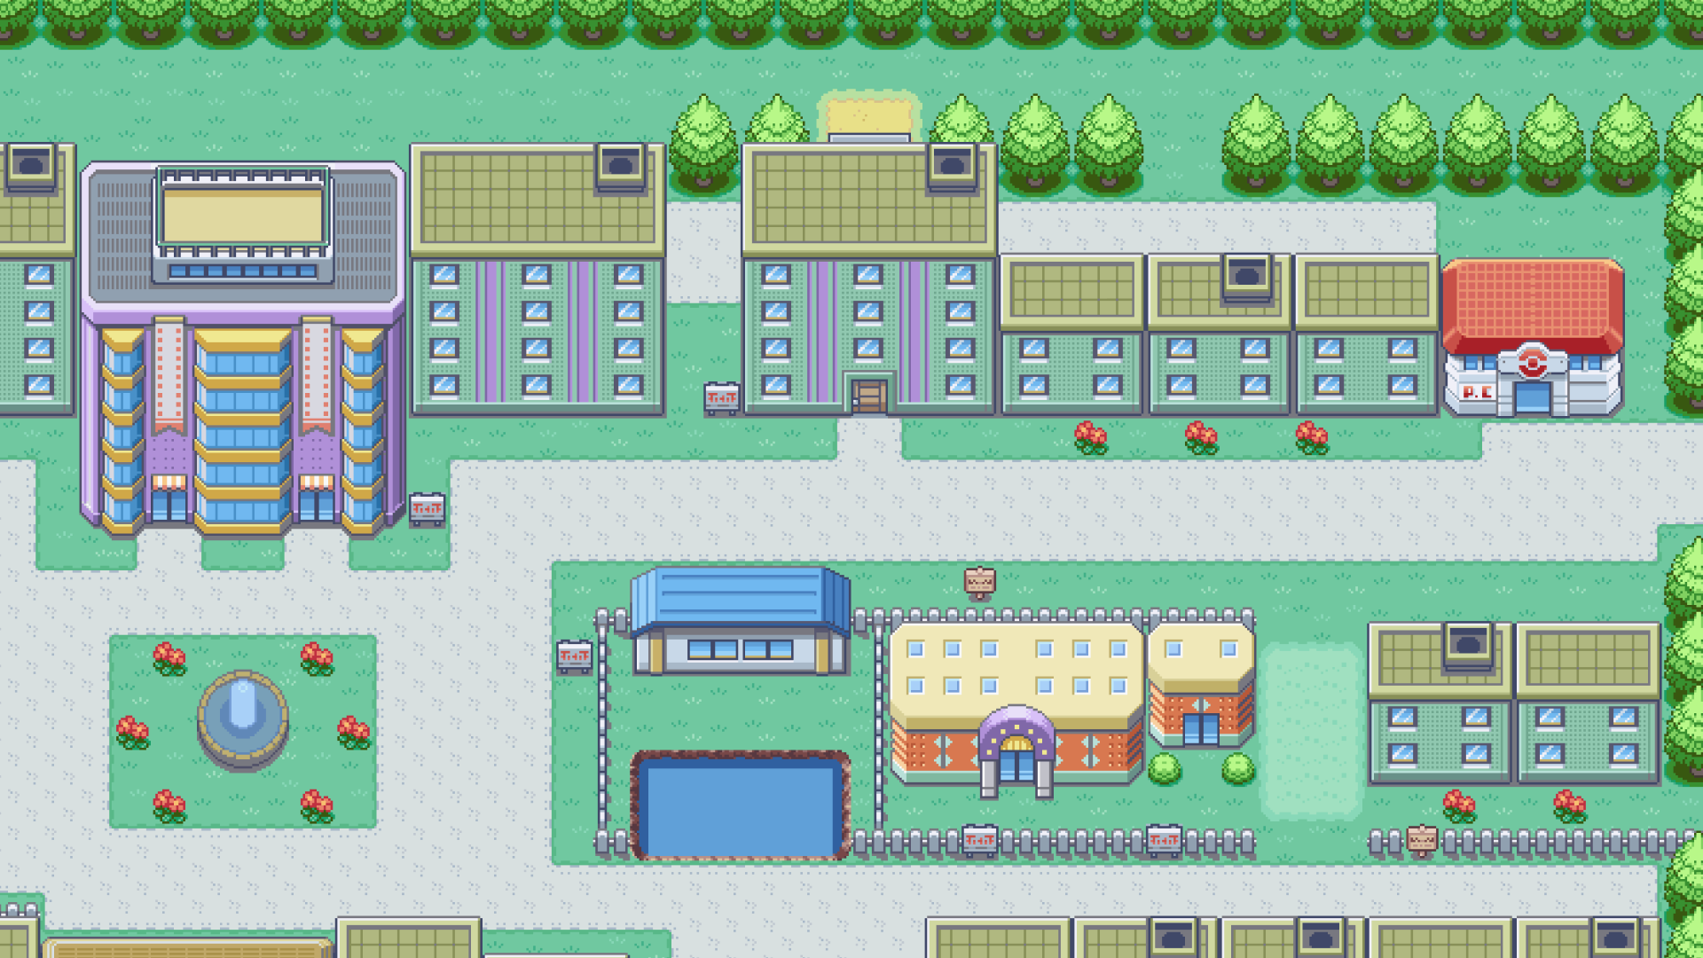

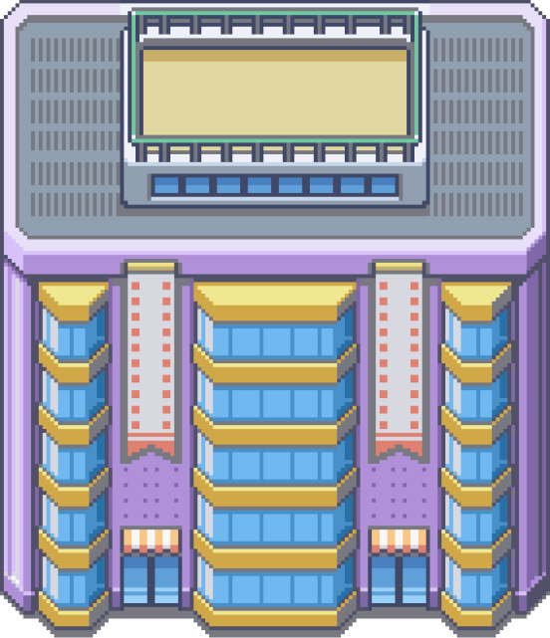
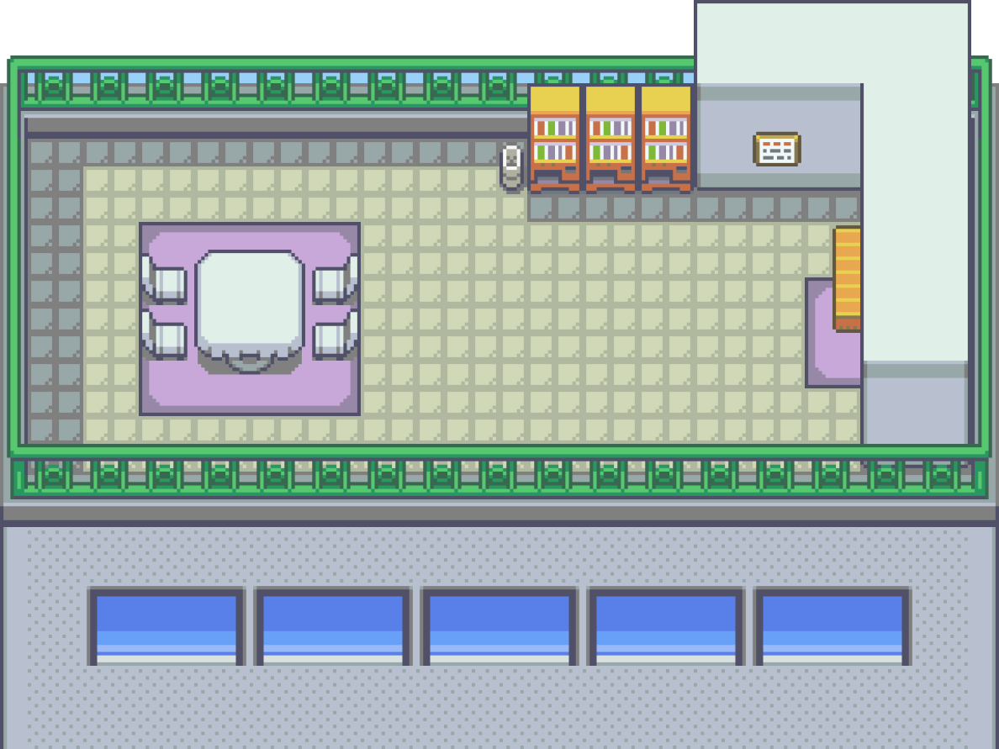






PROBLEM STATEMENT
Bird
Butterfly
Bee

Slide 4
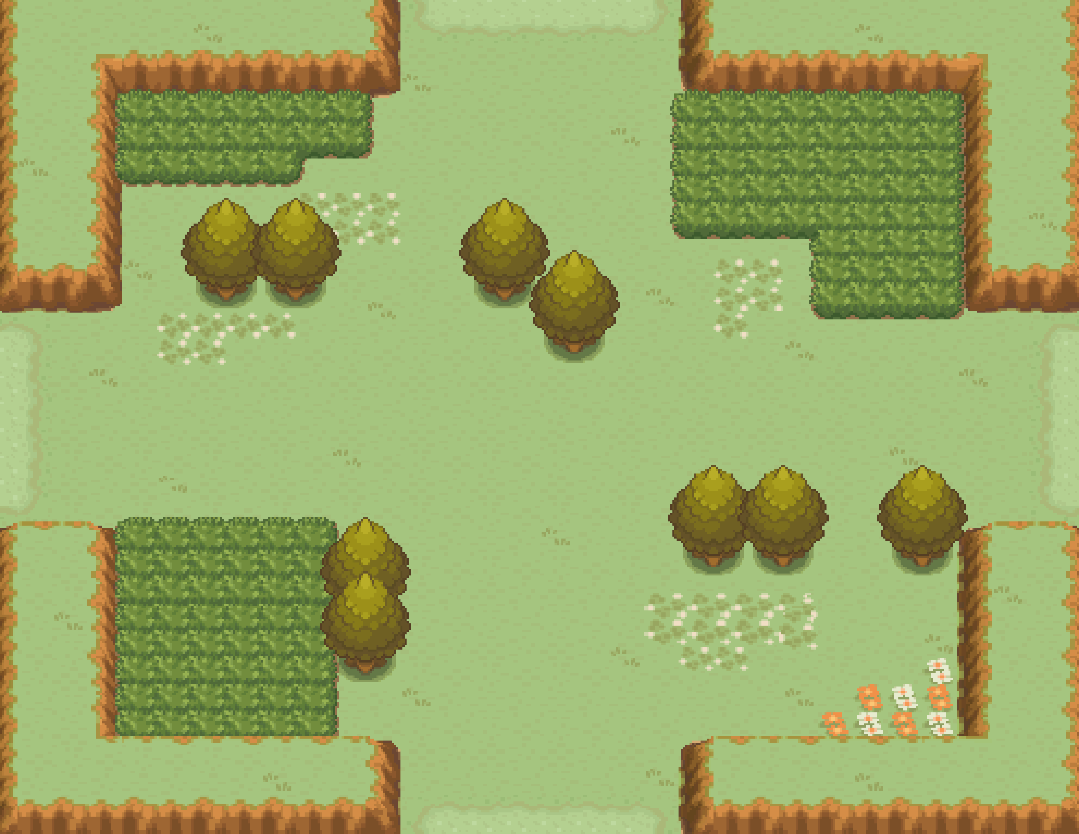




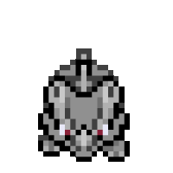



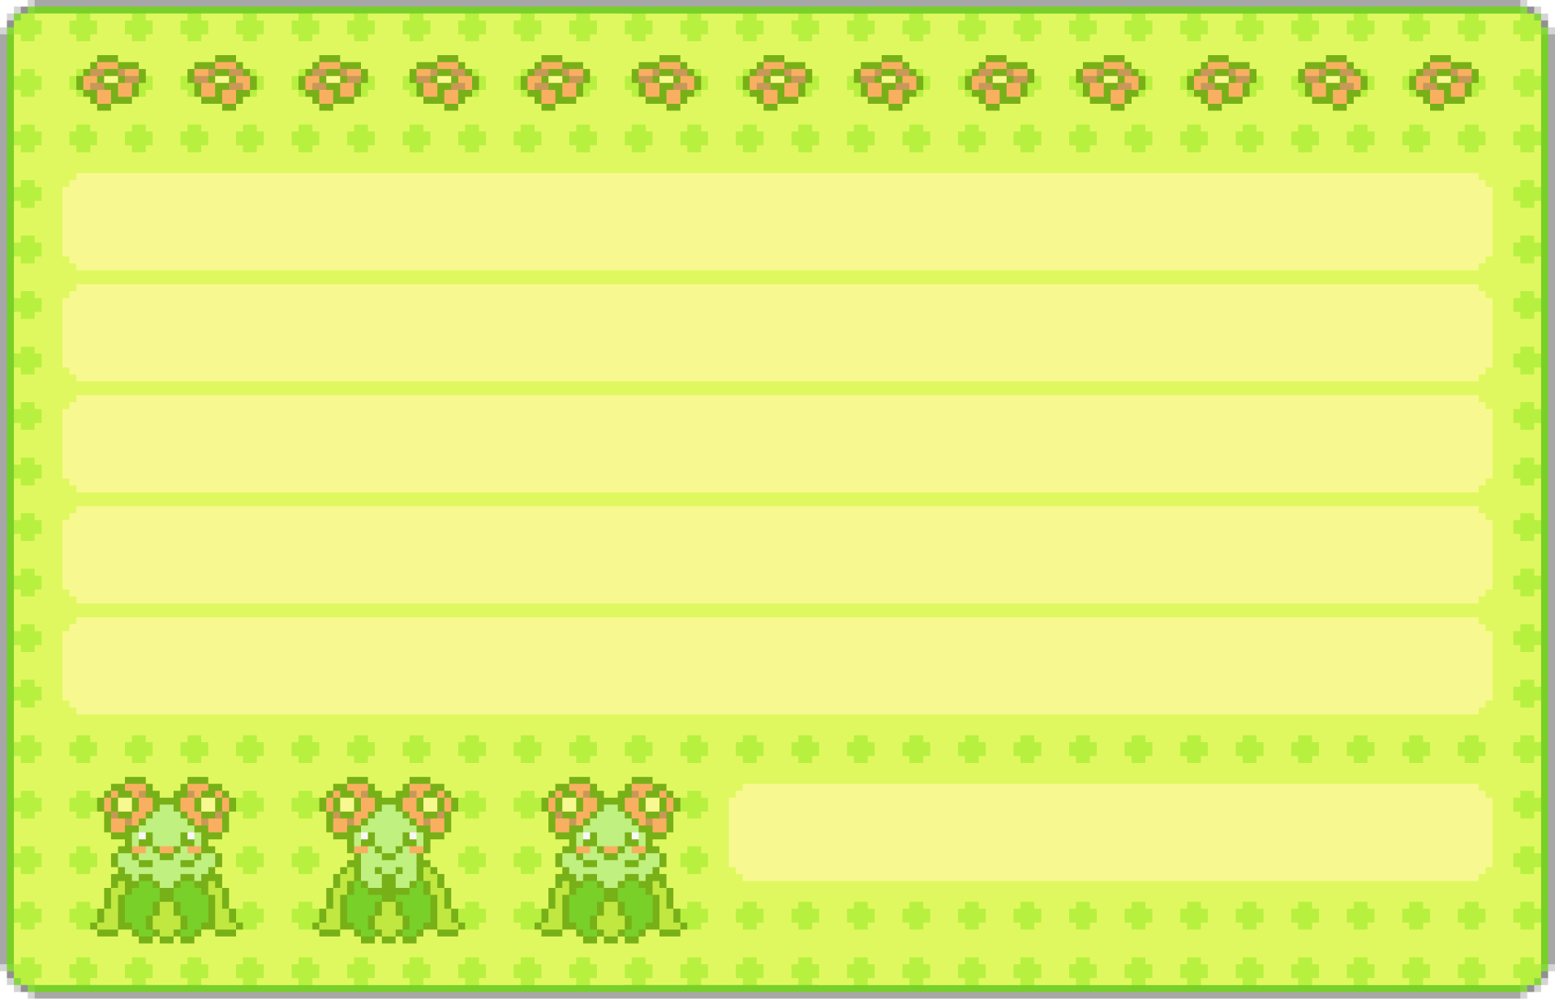
END USERS
Game enthusiasts
Teenagers
Content creators
Gameplay viewers
Pokemon fans
Open land covered in tall grass. Hot summers and cold winters, moderate rainfall. Lightning can ignite fires that burn away dead plants and promote new growth. This cycle of burning and regrowth helps maintain the ecology.

Slide 5



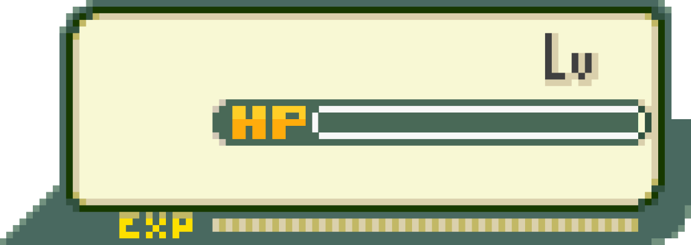
FUNCTIONALITIES PLANNED
3
6
50/50
Pokemon Battles
Nintendo Experience
RAINFO
DESERT

Slide 6
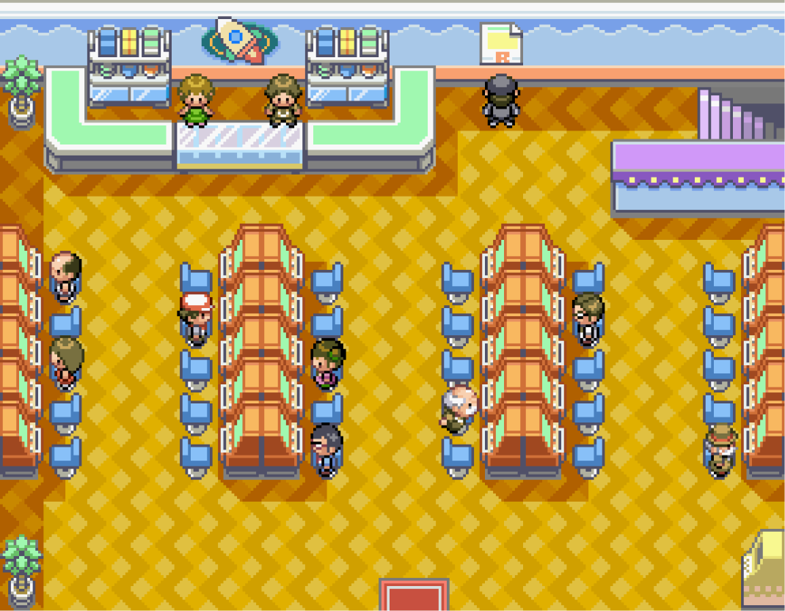
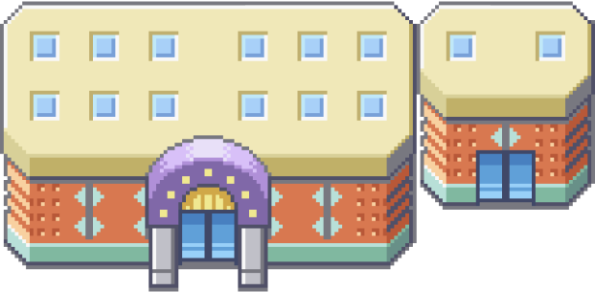
DIVISION OF WORK
Pranav H: Logic and GUI
Noel J: Logic, Design and GUI
Pranav R: Logic
Pragathi P: Graphic Design

